Slide 1



Business plan of international digital social company
Yevheniia Andriichenko
Safet Softic

Slide 2
Basics of Business Planning
Guide to starting a business | 2025
Quick guide for business startups
Idea
Find Business idea
Planning
Trade law
Starting
Personal qualities
Selecting a legal form
Choosing a location
Business premises law
Marketing and competition
Preparing a business plan
Budget
Financing
Capital requirements
Subsidies
Social insurance
Taxes
Trade registration
Other authorities
Startup costs
Startup Service consultation
Overview of the steps to starting a business

Slide 3
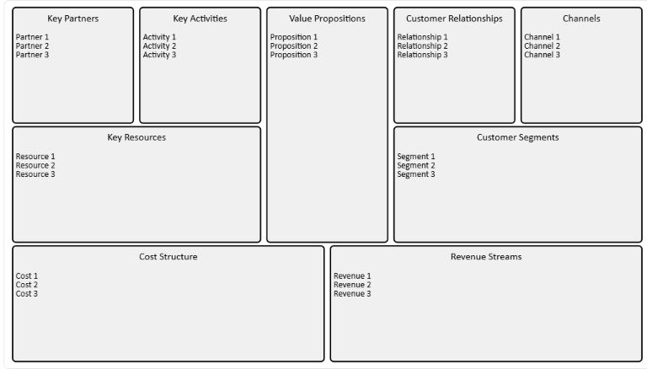
Business Idea
Link
Business Model Canvas

Slide 4
Global statistics on ‘death at the idea stage’ and early stage
According to various studies, about 90% of business ideas never become full-fledged start-ups — they remain unrealised or are closed down even before the company is registered.
Among those ideas that do make it to business registration, about 20% close in the first year, and about 50% in the first 5 years.
In Europe (GEM data): only 1 in 3 people planning to start a business actually take the first steps (registration, first customers). The remaining 2/3 remain at the ‘idea’ stage.
(Source: GEM – Global Entrepreneurship Monitor, research on entrepreneurship in more than 50 countries, Eurostat, OECD business demography)

Slide 5
Key reasons why businesses ‘die’ at the idea stage
No clear understanding of the market and customers → no one
needs the product.
No financial plan → not enough money at the start.
No clear business model → unclear how to make money.
Weak team/lack of roles → the idea does not translate into an organization.
No step-by-step plan (milestones) → the entrepreneur loses
focus and motivation.

Slide 6
BusinessPlan structure
Step 1 Product or Service
1.1. Description of the product/service
1.2. Stage of development (idea, prototype, ready-to-market)
1.3. Unique sellingproposition (USP)
1.4. Benefits forcustomers
1.5. Competingproducts/services
Step 2 Market and Competition
2.1. Market size and structure
2.2. Currentmarkettrends
2.3. Target groups (customer segments)
2.4. Main competitors (strengths/weaknesses)
Step 3 Marketing and Sales
3.1. Offering (what, to whom)
3.2. Pricing and terms of payment
3.3. Advertising and PR strategy
3.4. Sales channels (online, offline, distributors, direct sales)
Step 4 Company and Management
4.1. Company name and mission
4.2. Founding date, legal form
4.3. Owners and managing directors
4.4. Ownership structure
4.5. Team members and qualifications:
4.6. Organisation and division of responsibilities
4.7. External partners (e.g. taxadviser, consultants)
4.8. Business location
Step 5 Success and Financial Planning
5.1. Requiredcapital
5.2. Sources of financing (equity, loans, subsidies)
5.3. Costs (fixed, variable, personal)
5.4. Forecast of revenues and profits
5.5. Planned results (profit/loss projection)
Step 6 Implementation Plan – Milestones
6.1. Key steps to implement the idea
6.2. Responsibilities (who does what)
6.3. Timeline and milestones

Slide 7
Step 1. Product or Service
1.1. Description of the product/service
    What is it? (product, digital service, consulting, etc.).
    Key features, functions, technologies.
    Compliance with European standards:
        CE certification
        Environmental requirements
        General Data Protection Regulation (GDPR
Notes:
Describe your products and services in detail, their strengths and weaknesses, stage of development (e.g. prototype), customer benefits, potential USPs and the main competing offers.

Slide 8
Step 1. Product or Service
1.2. Stage of development
  Idea / Prototype / Market-ready / Scaling
  What resources have already been invested, what steps are still needed (R&D, testing, patents, certification, clinical trials, etc. for regulated sectors).
EUIPO European Union Intellectual Property Office responsible for managing the EU trade marks and the registered European Union designs, and EU geographical indications for craft and industrial products.

Slide 9
Step 1. Product or Service
1.3. Unique selling proposition (USP)
  How does it differ from competitors? (price, quality, service, innovation).
  Can the idea be protected by a patent, copyright or trademark in the EU?
  Tools: Value Proposition Canvas, Blue Ocean Strategy, SWOT analysis.

Slide 10
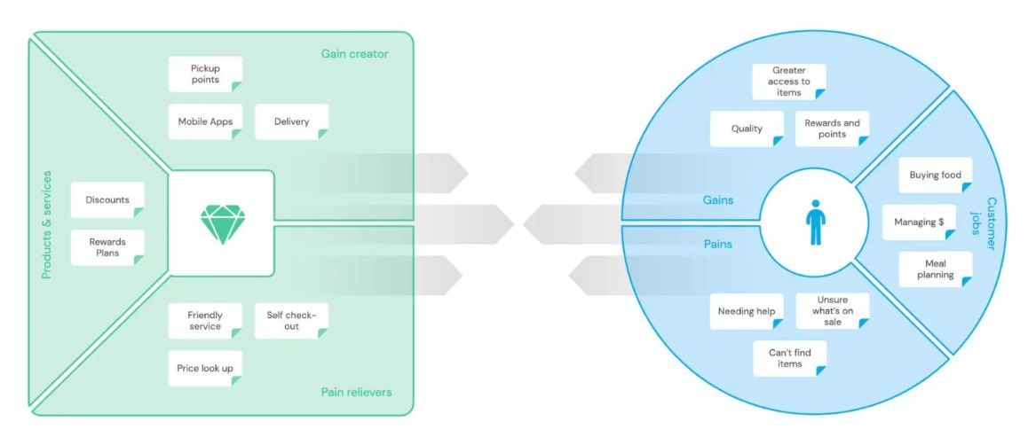
ValuePropositionCanvas
Exsample

Slide 11
Step 1. Product or Service
1.4. Benefits for customers
  What problem does the product solve?
  Measurable benefits (saving money/time, convenience, sustainability).
  Alignment with EU market values (environmental friendliness, social responsibility, digitalization).

Slide 12
Step 1. Product or Service
1.5. Competing products/services
  Who are the key competitors in the EU?
  Their strengths and weaknesses. It is important to show how your product stands out among them.
Tools: Competitive Analysis, Porter’s Five Forces, Benchmarking.

Slide 13
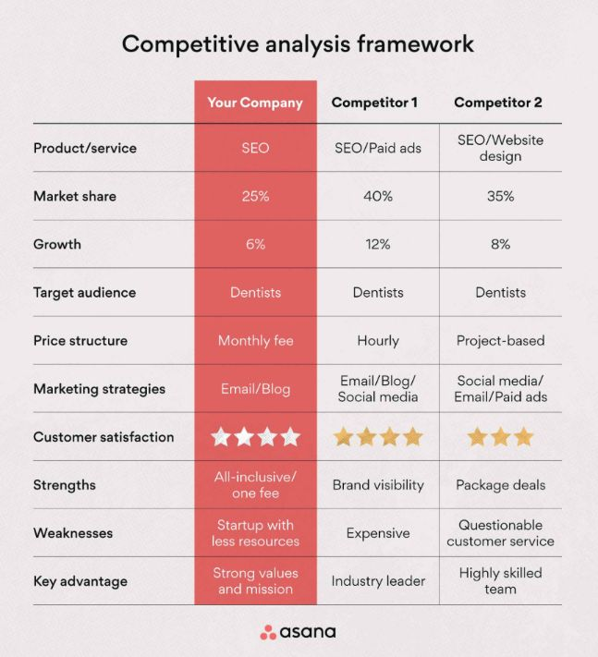

Slide 14
Step 2
Market and Competition
2.1. Market size and structure
  Define TAM, SAM, SOM. Show data in figures (in € or number of users).
  Market structure: B2B/B2C, regional distribution, online/offline.
  Sources: Eurostat, European Commission reports.
Notes:
Present the data from your market and competitor research, such as: what is your market and how large is it? What are the indicators as far as market trends and developments? Which target group are you addressing?

Slide 15
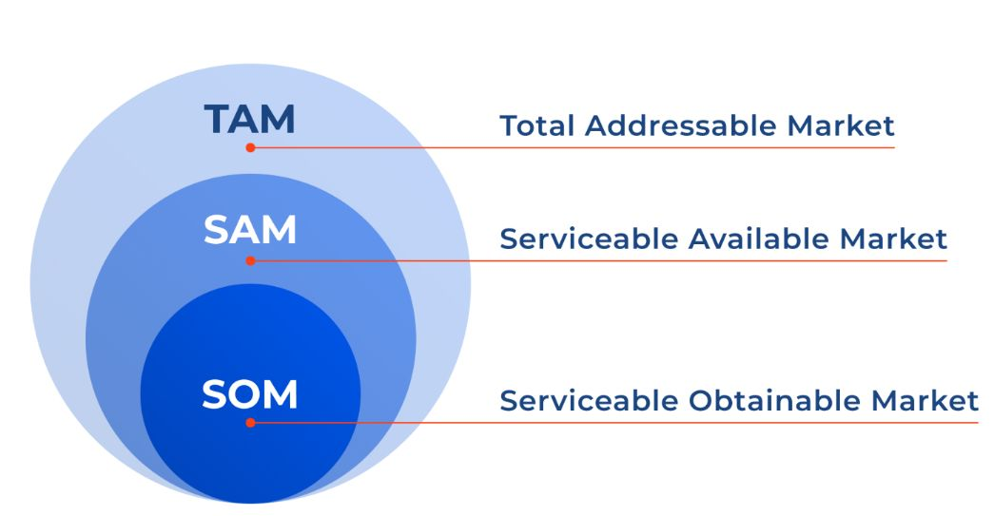
All possible market capacity: How much money or how many customers exist in the world/EU for your product or service.
Example: The food delivery market in the EU is estimated at €100 billion.
The partof TAM whereyoucanactuallyoperate, takingintoaccountgeography and segment. Yourtargetaudiencewithinaccessible countries orsaleschannels.
Example: fooddelivery in Austria and Germany = €10 billion.
Achievable market (the part of SAM that you can realistically capture in the coming years).Takes into account your resources, competition, and marketing.
Example: if a company plans to capture 1% of the Austrian market → €50 million.

Slide 16
Step 2
Market and Competition
2.2. Current market trends
EU trends: digitalization, sustainability, circular economy, e-commerce, AI, green transition.
Impact of regulations: GDPR, EU Green Deal, eco-labelling, PESTEL-Analysis.

Slide 17
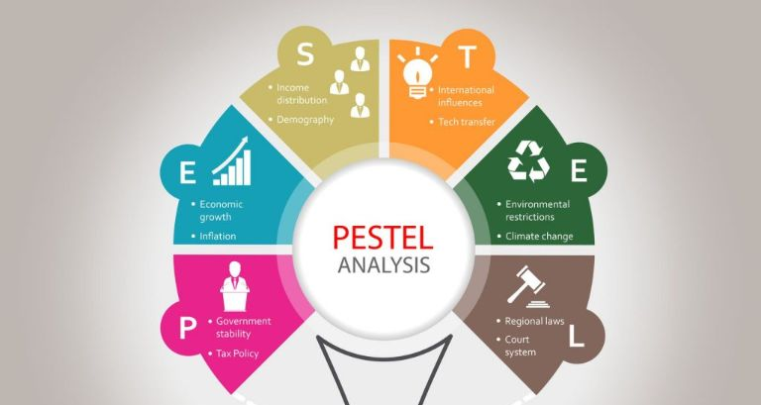

Slide 18
Step 2
Market and Competition
2.3. Target groups (customer segments)
Who are your customers?
Personalized profiles (age, profession, interests).
Their pain points and needs.
Tools: Customer Persona Canvas, Customer Journey Map.

Slide 19
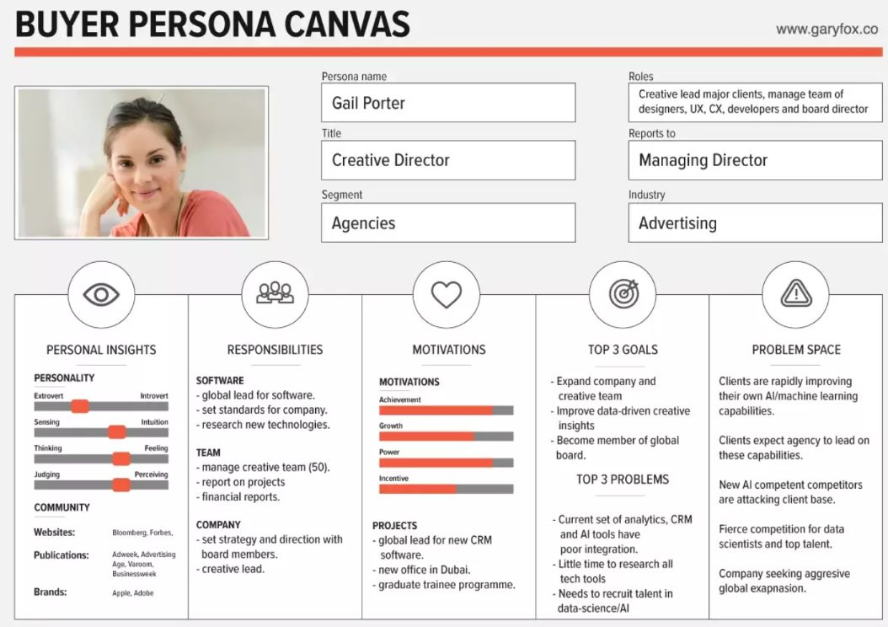

Slide 20
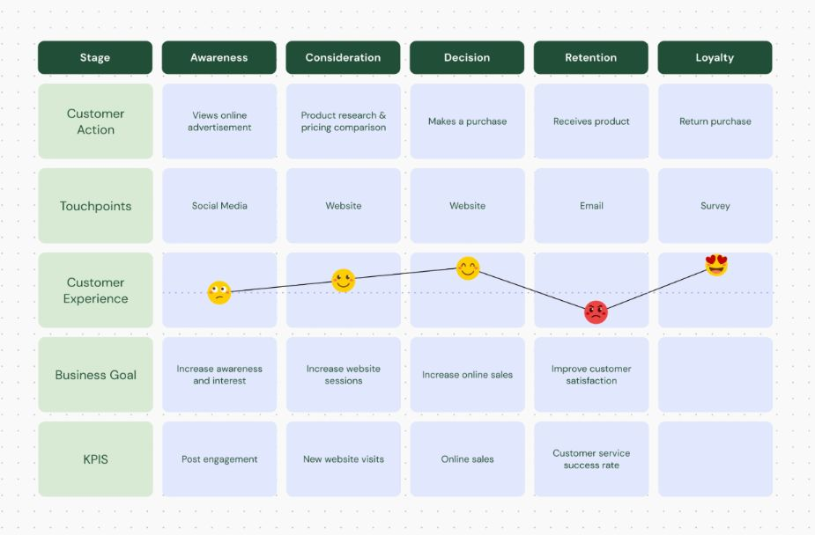
Customer Journey Map

Slide 21
Step 2
Market and Competition
2.4. Main competitors (strengths/weaknesses)
Comparison with 3–5 main competitors.
Table: Strengths/Weaknesses.
Tools: Porter’s Five Forces, Benchmarking, SWOT.

Slide 22
Step 3
Marketing and Sales
3.1. Offering (what, to whom):
  Describe what products/services you offer and for what audience (link to segments from Step 2).
  Show how your offer addresses customer pain points.
  Use the Value Proposition Canvas tool.
Notes:
Marketing and sales Describe the steps you are planning to take to implement your business concept. Offer: which products, services and consultations will you offer and to whom? Prices: what will your prices and payment conditions be? Communication: which advertising and PR measures are you planning and for which channels? Distribution: how will you be selling: directly, in a speciality shop, online, etc.?
Marketing Mix 4P/7P (Product, Price, Place, Promotion + People, Process, Physicalevidence).
Customer Journey Map — путь клиента от осведомлённости до покупки.
CRM-системы (HubSpot, Pipedrive, Salesforce) — управление продажами.
Google Market Finder — для выхода на рынки ЕС.

Slide 23
Step 3
Marketing and Sales
3.2. Pricing and terms of payment:
      Pricing strategy:
          Cost-based,
          Value-based (based on value to the customer),
          Competition-based (based on the market).
      Payment terms: advance payment, instalments, subscription model, SaaS.

Slide 24
Step 3
Marketing and Sales
3.3. Advertising and PR strategy:
    Channels: digital (social media, Google Ads, SEO), offline (exhibitions, eventmarketing).
    PR: mediapublications, collaborations, expert articles.
    Important in Europe:
          GDPR (personal data in email marketing).
          Eco-labelling (iftheproductis ‘green’).
    Tools: AIDA model, Marketing Mix 7P.

Slide 25
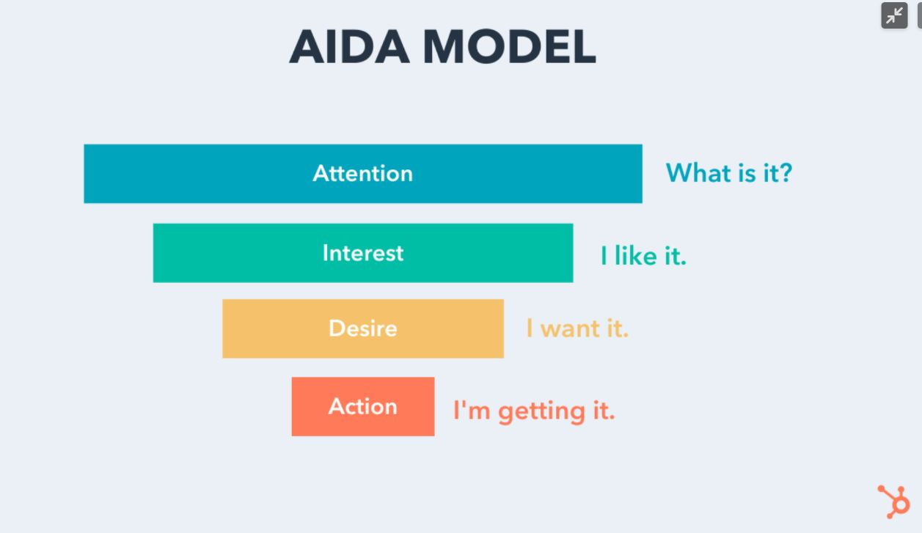

Slide 26
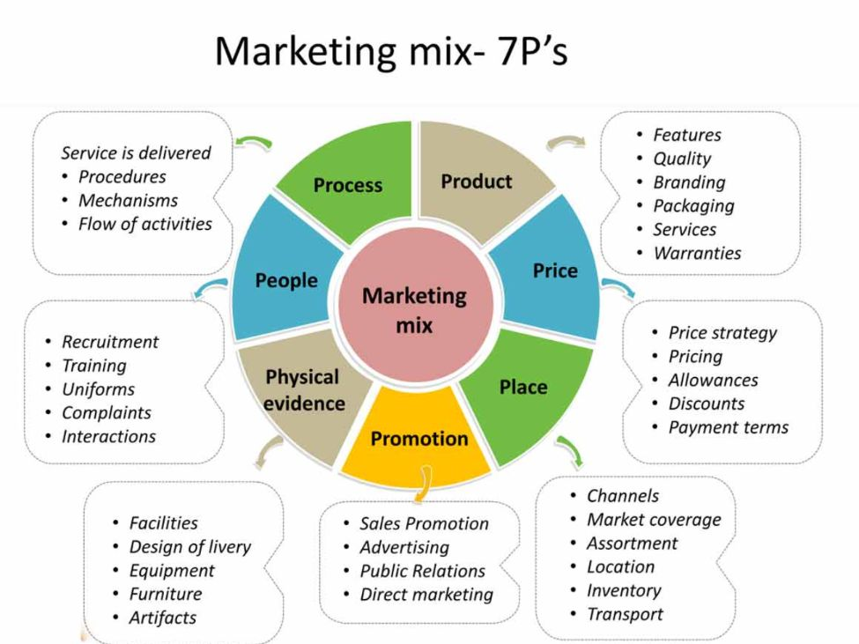

Slide 27
Step 3
Marketing and Sales
3.4. Sales channels (online, offline, distributors, direct sales)
  Online: e-commerce, marketplaces (Amazon EU, Zalando, Etsy).
  Offline: shops, pop-upstores, distributors.
  Directsales: via website, subscription, franchise.
  Itisimportanttoconsideromnichannelretailing (a combinationof online and offline).

Slide 28
Step 4
Company and Management
4.1. Company name and mission:
4.2. Founding date, legal form:
4.3. Owners and managing directors:
4.4. Ownership structure:
4.5. Team members and qualifications:
4.6. Organisation and division of responsibilities:
4.7. External partners (e.g. tax adviser, consultants):
4.8. Business location

Slide 29
Legal Forms in Austria
Compare forms on liability, representation, accounting duty, and tax: GmbH/FlexCo pay 23 % corporation tax; sole traders & partnerships pay personal income tax. wko.at
Form | Liability | Capital - Start-up cost | Team-work? | Typicaluse-case
Sole Proprietor | Unlimited | Low | Not built-in | Freelancers, micro-shops
OG (General Partnership) | Partners unlimited & joint | Very low | Yes | Two-person retail/consulting
KG (Limited Partnership) | General partner unlimited; limited partner capped | Low | Yes | Investor + active founder
GmbH | Limited to share capital | Higher (min € 10k) | Yes | Growth SMEs
FlexKapG / FlexCo | As GmbH + employee shares | Similar to GmbH | Yes | Start-ups seekinginvestors

Slide 30
Choosing the right legal form
Tip: WKÖ’s Legal Form Guide walks you through decision criteria (liability, capital, tax, social insurance). wko.at
Legal form | Pros | Cons | Typical use-case
Sole proprietorship | Quick, cheap, full control | Unlimited personal liability, no team ownership | Micro & solo founders
GmbH / FlexKapG | Limited liability, tax perks from ≈ €150 k profit | Higher formation capital & running costs | Start-ups needing investor capital
OG / KG | Team ownership, easier transfer | OG partners fully liable; KG needs at least one unlimited partner | Family businesses, agencies

Slide 31

Legal formsabroad
LLC — Limited Liability Company (generic English term)
IKE — IdiotikiKefalaiouchikiEtaireia - “Private Company”- Greece
SIA — SabiedrībaarIerobežotuAtbildību - Latvia
OOD / EOOD — (Single-owner) - Bulgaria
SociedadeporQuotas+ Unipessoal (Lda.) - Portugal
Limited Şirket (Ltd. Şti.) – Türkiye

Slide 32

Company and management​
What to include (per WKÖ Guide) - Use this section of your business plan to describe the organisation and people behind the company.
  The WKÖ Guide lists these exact points under 2.6.2 Content of the business plan → Company and management
Company name & business purpose – your official company name and what the company does. (See also “Company designation” rules on distinctiveness & non-misleading names.) wko.at
Date of incorporation & legal form – when founded and which form (e.g., e.U., OG/KG, GmbH, FlexKapG). wko.at
Shareholders & managing directors (MD) – who owns the company and who manages it. (If applicable, note both the commercial managing director and any managing director under trade law.) wko.at

Slide 33
Company and management​
Ownership structure – cap table/percentages or voting rights overview. wko.at
Team members & competencies – key roles, qualifications, and experience. wko.at
Responsibilities / organisation – how tasks and decisions are divided (org chart, RACI (Responsibility-Accountable-Consulted-Informed - roles matrix), or brief role list). wko.at
External partners (e.g., tax adviser) – essential outsourced experts or service providers. wko.at
Location(s) – registered office and any branches/production sites. wko.at

Slide 34

Taxes, finance & accounting abbreviations
VAT / USt — Value-Added Tax / Umsatzsteuer
P&L — Profit and Loss (income statement)
COGS — Cost of Goods Sold (variable cost of sales)
OPEX — Operating Expenses (usually fixed/overhead)
CAPEX — Capital Expenditures (investments in equipment, fit-out, etc.)
EBITDA — Earnings Before Interest, Taxes, Depreciation, and Amortization
PBT — Profit Before Tax
DSCR — Debt-Service Coverage Ratio (cash flow ÷ loan payments)
APR — Annual Percentage Rate (loan interest incl. fees)
KPI — Key Performance Indicator
CAC — Customer Acquisition Cost
WIP — Work in Progress (unfinished production/inventory)
YTD — Year-to-Date (from Jan 1 to today)
FTE — Full-Time Equivalent (headcount measure)

Slide 35

Company and management​
Mini template - Summary
  Name & purpose:[e.g., FlexCo Labs GmbH – develops B2B workflowsoftware]
  Founded / legal form:[e.g., 12 Sep 2025 – FlexKapG]
  Shareholders / MDs:[e.g., A 60%, B 40% / Managing Director: C]
  Ownership structure:[briefcaptableorclasses]
  Team & competencies:[keyroles + 1–2 strengthseach]
  Responsibilities / org:[wholeadsproduct, sales, ops; decisionrules]
  External partners:[taxadviser, payroll, IP attorney]
  Location(s):[HQ + additional sites]

Slide 36
Step 5
Success and Financial Planning
5.1. Required capital
5.2. Sources of financing (equity, loans, subsidies):
5.3. Costs (fixed, variable, personal)
5.4. Forecast of revenues and profits:
5.5. Planned results (profit/loss projection)

Slide 37

Success & Financial Planning - One-page fill-in template
Capital requirements (start-up budget)
  Investments (CAPEX):fit-out, equipment, IT, vehicles, deposits for rent/utilities
  Initial/one-off costs:company setup, licences, branding, website, launch marketing
  Initial inventory:first stock / materials
  Working capital:3–6 months of fixed costs + one month of COGS – supplier credit
  Contingency:10–15% buffer
  = Total capital required

Slide 38

Success & Financial Planning - One-page fill-in template
Financing mix (how you’ll fund it)
  Own funds & founder loans:cash + any in-kind assets
  Borrowed capital:bank/micro-loan (term, rate), leasing, overdraft
  Public support:grants/subsidies, guarantees (note: often reimbursed after purchase)
  Partners/investors:equity contribution for shares
  Target structure: aim for ≥20–30% equity, DSCR ≥ 1.2 on loans
Cost structure (monthly run-rate)
  Fixed costs:rent, wages, insurance, software, accounting, telecom, licences
  Variable costs:COGS/materials, shipping, payment fees, packaging, commissions
  Founder’s living draw/salary:treat as a cost in the plan
  Tax & social-insurance set-aside:reserve a % of revenue/profit to avoid surprises

Slide 39
Success & Financial Planning - One-page fill-in template
Sales & revenue (bottom-up)
  Offer & price:products/services, average price
  Volume drivers:footfall or leads × conversion × orders per customer ⇒ [ ] units/mo
  Seasonality/ramp:month-by-month growth assumption
  Revenue = price × units (by product line/channel) → €[ ]/mo (ramp: M1 [ ]% → M3 [ ]% → steady)
  Gross margin:1 – variable-cost % → [ ]%
  Break-even revenue:Fixed costs ÷ Gross-margin % → €[ ]/mo
Business figures & development
  Year-1 totals: Revenue €[ ] • COGS €[ ] • Gross profit €[ ]
  Fixed costs€[ ] • EBITDA €[ ] • Interest €[ ] • PBT €[ ]
  Key metrics: EBITDA margin[ ]% • DSCR (debt-service coverage) ≥ 1.2 • Cash runway[ ] months
  Sensitivity (whatmovestheneedle): +€0.50price ⇒ +€[ ]/yrprofit; +10%volume ⇒ +€[ ]/yrprofit.

Slide 40

Workedexample - Small café
Capital requirements (one-off)
  Fit-out & equipment (espressomachine, counters, seating): €35,000
  Deposits & one-off setup (rent, licences, branding, launch): €6,000
  Opening stock (coffee, milk, pastries): €2,000
  Branding, website, menuboards, POS: €1,500
  Launch marketing & hiringcosts: €1,500
  Working capital (4 monthsfixedcosts):seebelow → €37,000 × 4? (calculate after fixeds)
  Contingency (10% ofabove CAPEX + start-up):€4,600
  First computefixedmonthlycosts, thensetworkingcapital.
  → Total capitalrequired:€87,600

Slide 41
Workedexample - Small café
Monthly coststructure (steadystate)
  Fixed:rent€2,000; wages (2 FTE) €6,000; utilities €500; insurance€200; software/POS €100; accounting€150; marketing€300 → Fixed total = €9,250
  Variable: COGS (beans, milk, pastries) ≈ 30% ofsales; disposables & paymentfees ≈ 5% → Variable ≈ 35% → Gross margin ≈ 65%
  Working capital (4 monthsfixed): €9,250 × 4 = €37,000
  Total capital (rounded): €35,000 + 6,000 + 2,000 + 1,500 + 1,500 + 37,000 + 4,600 ≈ €87,600
Financing mix
  Equity (owners):€30,000 (~34%)
  Bank loan:€50,000 (5 yrs@ 5%)(~57%)
  Grant/guarantee:€7,600 (equipment/consulting support) (~9%)
  Equity share ≈ 34%; comfortableforbankfinancing.
  Financing mix: Equity 34% • Debt 57% • Grants 9%

Slide 42
Workedexample - Small café
Sales & revenueforecast (month 4 steadystate)
  Footfall: 120 customers/day, 26 days/month → 3,120 transactions
  Average ticket: €5.50 → Revenue ≈ €17,160 / month
  COGS (35%) ≈ €6,006 → Gross profit ≈ €11,154
  EBITDA ≈ Gross profit – Fixed (€9,250) = €1,904 (beforeloaninterest & taxes)
  Break-even revenue
  = Fixed €9,250 ÷ Gross margin0.65 ≈ €14,230 / month
  → At theassumedtraffic, you’reabovebreak-evenby ~€2.9k revenue.

Slide 43
Workedexample - Small café
Ramp assumption (first 6 months)
  M1: 70% ofsteady → rev€12,012 (belowbreak-even; expect cash burn)
  M2: 85% → €14,586 (≈ break-even)
  M3: 95% → €16,302
  M4+: 100% steady → €17,160 (targettoexceed via upselling/seasonaloffers)
Year-1 outline
  Revenue: €190–210k (seasonality & ramp)
  COGS (35%):€69,069 → Gross profit €128,271
  Gross margin: ~65%
  OPEX (fixed): ~€111k - Fixed costs:€111,000
  EBITDA: €15–20k (pre-interest/tax) → EBITDA €17,271
  Loan interest (yr-1 est.): ~€2,300 → Profit before tax ≈ €15,000
  Debt service (cash): ~€943/mo annuity → DSCR ≈ 1.3× (on steady months)
  Sensitivity: a €0.50 ticket increaseor +10 customers/daylifts EBITDA by ~€10–12k/year.

Slide 44
Workedexample - Small café
What’s inside (assumptions)
  Revenue steady state: €17,160 / month with a ramp (70%, 85%, 95%, then 100%).
  Variable costs: 35% of revenue → gross margin 65%.
  Fixed costs: €9,250 / month.
  Loan: €50,000, 5 years, 5% interest → annuity payment calculated.
  Starting cash buffer (working capital): €37,000.
  Columns include Revenue, COGS, Gross Profit, Fixed Costs, EBITDA, Loan Interest/Principal, Cash Flow (pre-tax), End Cash each month.

Slide 45
How to adapt this to your business ?
Service business
Replace COGS with delivery hours × hourly pay
track utilization instead of ticket size.
E-commerce
Add shipping & returns to variable costs
model ad spend → traffic → conversion explicitly.
Manufacturing
Split variable costs into materials + direct labor + machine time
add WIP inventory to working capital.

Slide 46
ThankYou :-)

